Slide 1






TEAM NAME: INNO IT
PATHWAY X FLEXPRICE
Adaptable Solutions for a Dynamic World....

Slide 2

METHODOLOGY
The development of the Smart Research Assistant began with identifying the gaps in existing research tools. Our methodology focused on combining document analysis with live data integration. The workflow starts with a user submitting a query or uploading documents such as PDFs. The backend pipeline then processes this input using Natural Language Processing techniques for information retrieval and summarization. Unlike simple summarizers, our system extracts citations and links them with the generated content, making it more reliable.

Slide 3


RESULT
Accuracy
The Smart Research Assistant was tested for both accuracy and efficiency. The system generated concise summaries that reduced the length of source documents by about 30–40 percent without losing critical points. Importantly, every major insight included a citation, which significantly improved the credibility of the results compared to traditional summarization tools.
Efficieny
Efficiency was also improved, as the assistant helped users cut down their research time by almost 60 percent. Reports were generated in an average time of five to seven seconds for medium-sized PDFs, making it highly practical in fast-paced environments.

Slide 4


PERFORMANCE METRICS
The tool also demonstrated strong scalability by handling multiple documents and sources at the same time. Users provided highly positive feedback, stating that the tool saved them hours of manual research and gave them more reliable outcomes. Students appreciated its use for assignments and projects, while startup teams highlighted how quickly they could gather competitor or market insights.
The assistant therefore proved its effectiveness by being not only accurate and reliable but also highly time-saving and user-friendly.

Slide 5

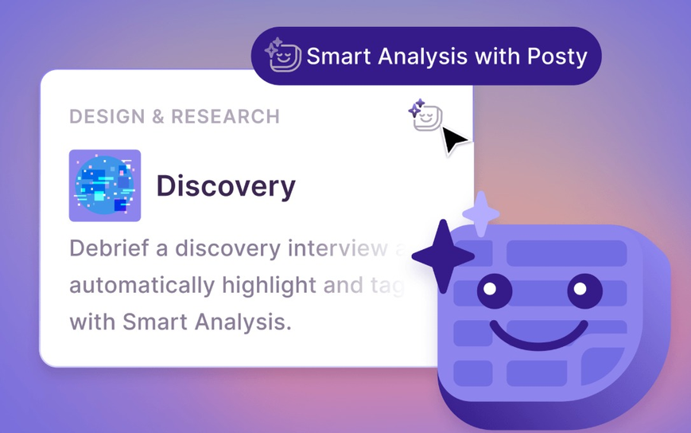

CHALLENGES & SOLUTIONS
Several challenges were encountered during development. One major issue was dealing with fragmented data coming from multiple formats such as PDFs, blogs, and websites. To solve this, we designed a modular ingestion pipeline that standardizes all inputs before analysis. Another challenge was the lack of trust in AI-generated content, as users often question whether the results are correct. This was solved by integrating citation extraction, which ensures that every generated answer is backed by a verifiable source.

Slide 6






CHALLENGES & SOLUTIONS
Keeping the system updated with fresh information was another obstacle, as static summaries quickly become outdated. By integrating Pathway for live ingestion, the system now automatically refreshes reports whenever new data becomes available. Cost management was also a challenge because of high API usage. To overcome this, we introduced caching and batching strategies to avoid redundant processing, thereby reducing costs while maintaining performance.
Through these solutions, the system evolved into a practical and scalable assistant that overcomes the limitations of traditional tools.
01
02

Slide 7


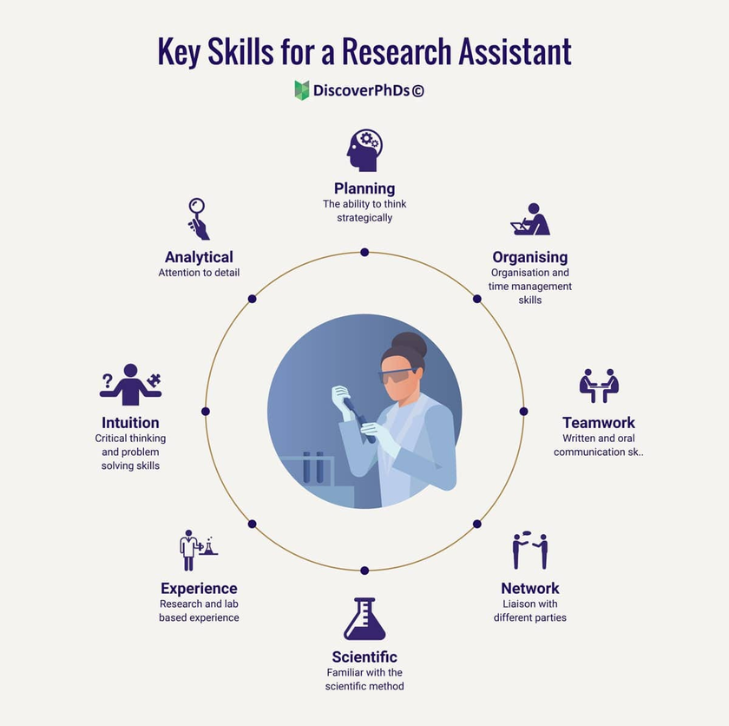
CONCLUSION & FUTURE WORK
In conclusion, the Smart Research Assistant provides a reliable solution to the problems of information overload, lack of trust, and outdated research. It combines concise summarization with proper citations and real-time updates, making it a valuable tool for students, teachers, researchers, and startup teams.
For the future, we plan to expand the system in multiple directions. File support will be extended to formats such as Word, Excel, and CSV. A voice-based assistant will be introduced to make the tool more accessible. We also aim to design a collaborative dashboard where teams can conduct research together, integrate plagiarism detection for originality checks, and use reinforcement learning to improve summaries based on user feedback. These improvements will further strengthen the Smart Research Assistant as a reliable and intelligent research companion.

